Slide 1
Bipyramids + Ag – Série CGCH-158C
Au@Ag nanorods ar made from a purified sample of bipyramids. Their cross section is pentatwinned.
Here I added increasing quantitied of silver, from 0,2 to 8 eq. The width will be almost constant and the length will increase.
There can be some impurities due to aggregation of bipyramids, or inhomogeneous deposition of silver on the bipyramids.
0,2 eq
0,4 eq
0,6 eq
0,8 eq
Rajouter BPs initiales
CGCH-158C
CGCH-158C1
CGCH-158C2
CGCH-158C3
CGCH-158C4
1 eq
2 eq
4 eq
8 eq
CGCH-158C5
CGCH-158C6
CGCH-158C7
CGCH-158C8

Slide 2
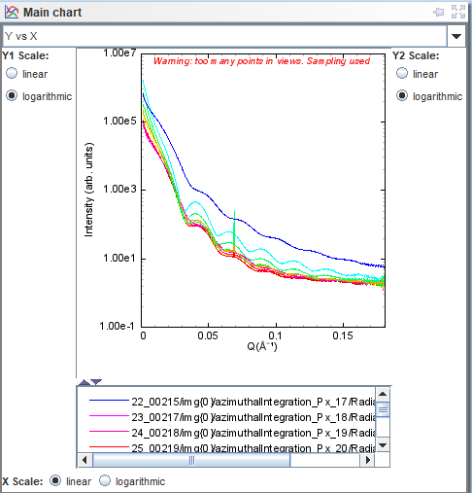
0,2 eq
0,4 eq
0,6 eq
0,8 eq
1 eq
2 eq
4 eq
8 eq
More Ag
Initial BPs

